Slide 1
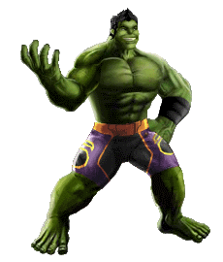
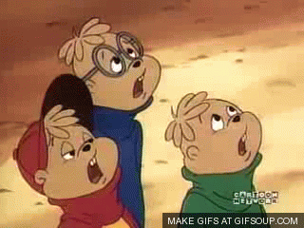
Yes, I am.
Wow! Are you tall?

Slide 2
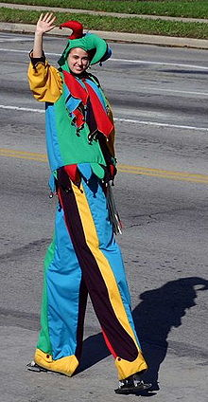
tall

Slide 3
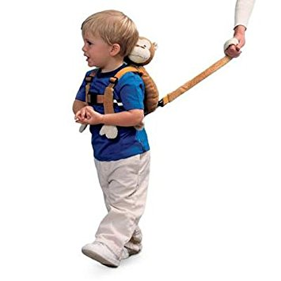
short

Slide 4
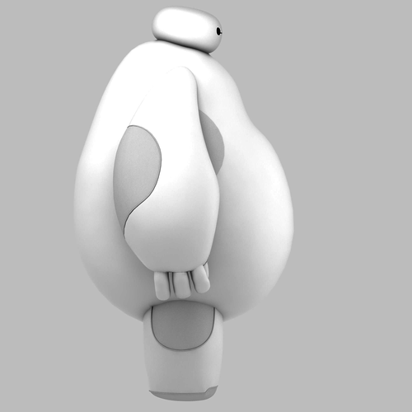
fat

Slide 5
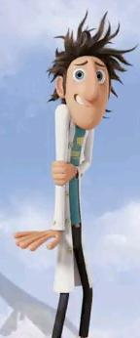
thin

Slide 6
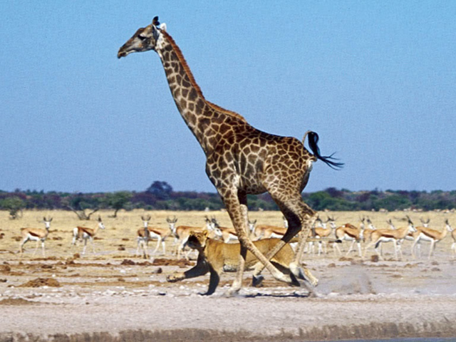
I’m tall.
I’m short.

Slide 7
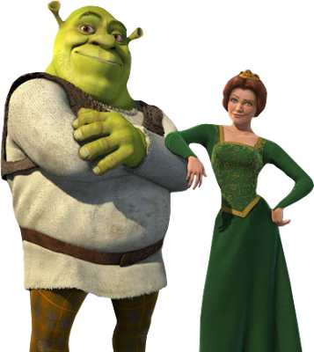
I’m fat.
I’m thin.

Slide 8
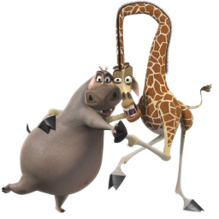
I’m tall and thin.
I’m fat and short.

Slide 9
Are you _______?
Yes, I am.
No, I’m not.

